Slide 1



Pandas

Slide 2




What Is Pandas?
most commonly used tools for Data Science and Machine learning.
Data manipulation
Data Cleaning
Analysis

Slide 3
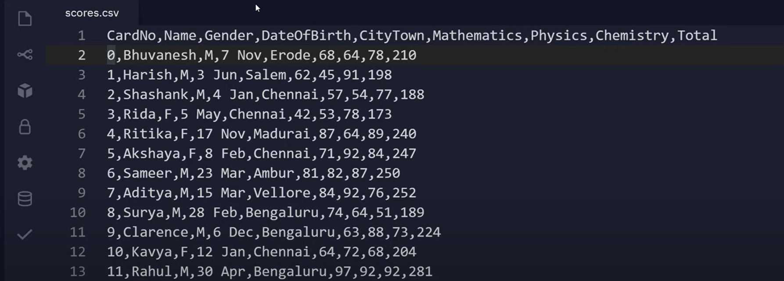

















Why Pandas?

Slide 4





1.Manually
2.File Handling
3.Through VB Programming in Excel

Slide 5

1.Manually
Lets just not talk about it.

Slide 6
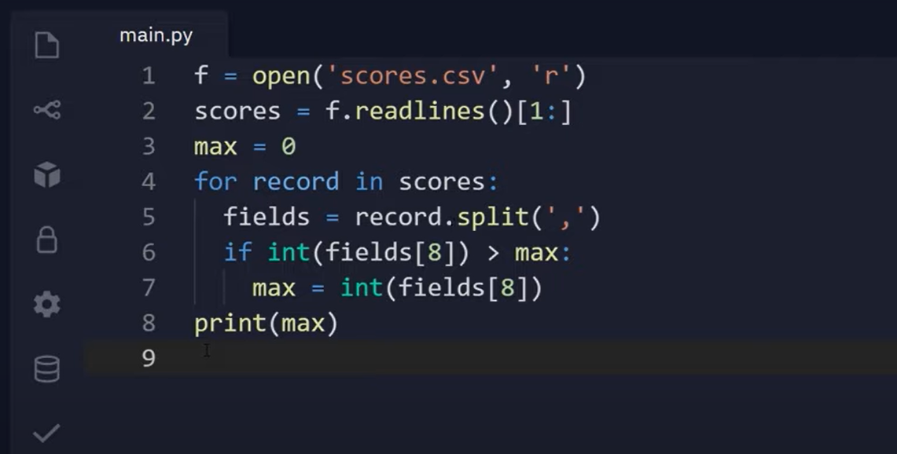











2.File Handling

Slide 7
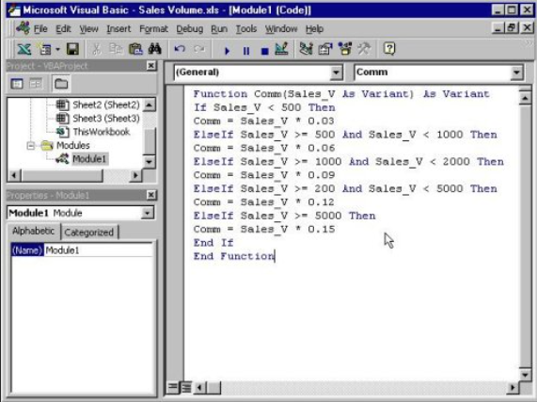



















3.Through VBA Programming In Excel

Slide 8











Slide 9
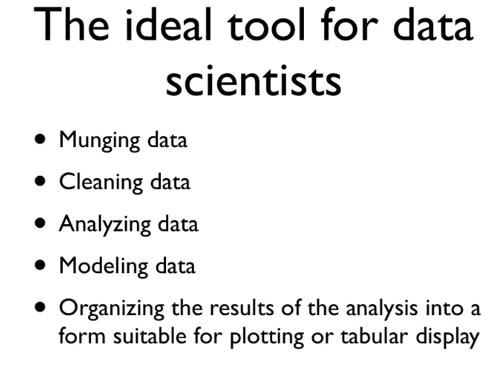


This has made Python even more powerful by granting it hold over the data.

Slide 10
Pandas introduction

Slide 11
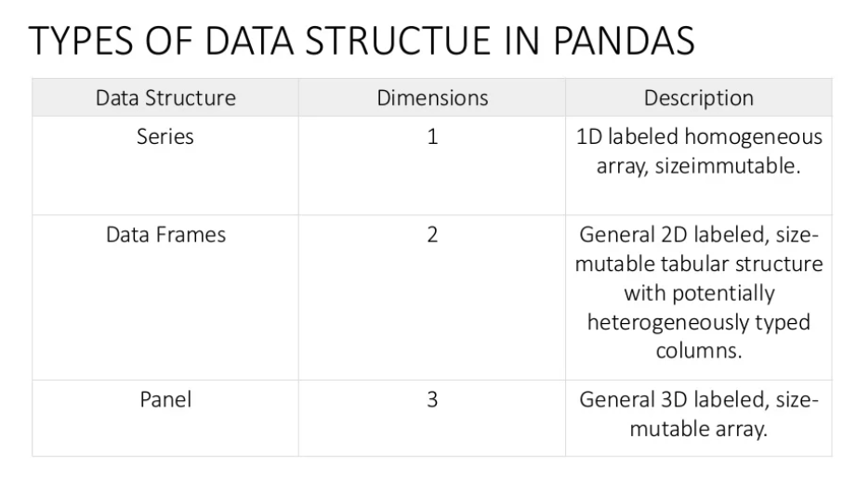

Slide 12
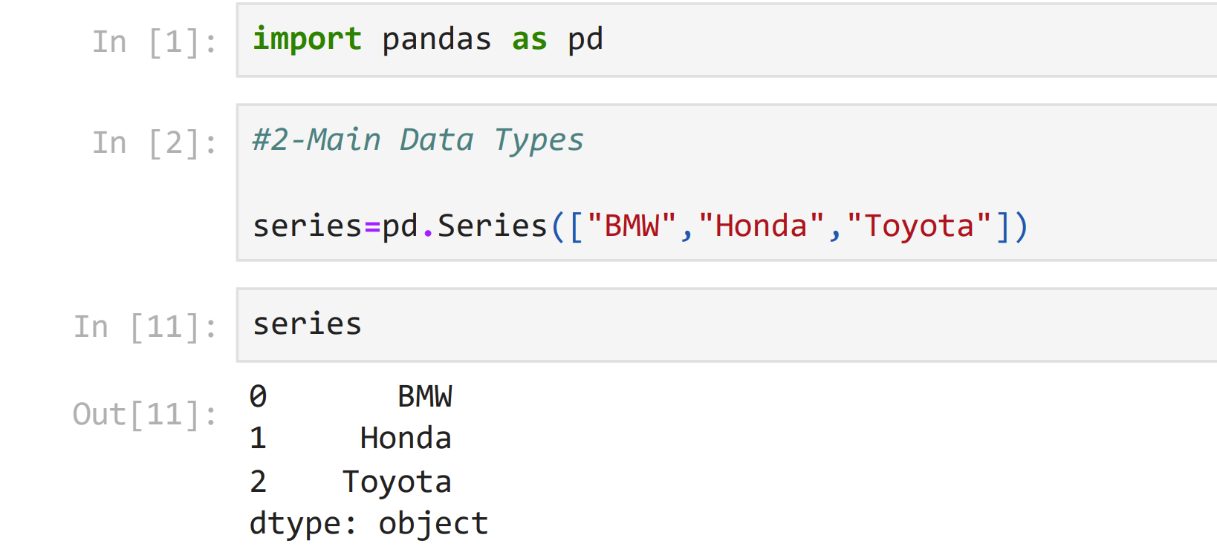

Let’s begin Pandas…

Slide 13
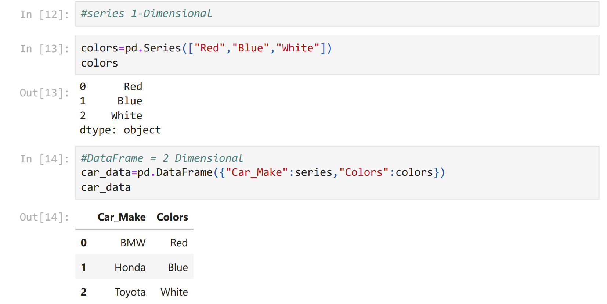

Slide 14
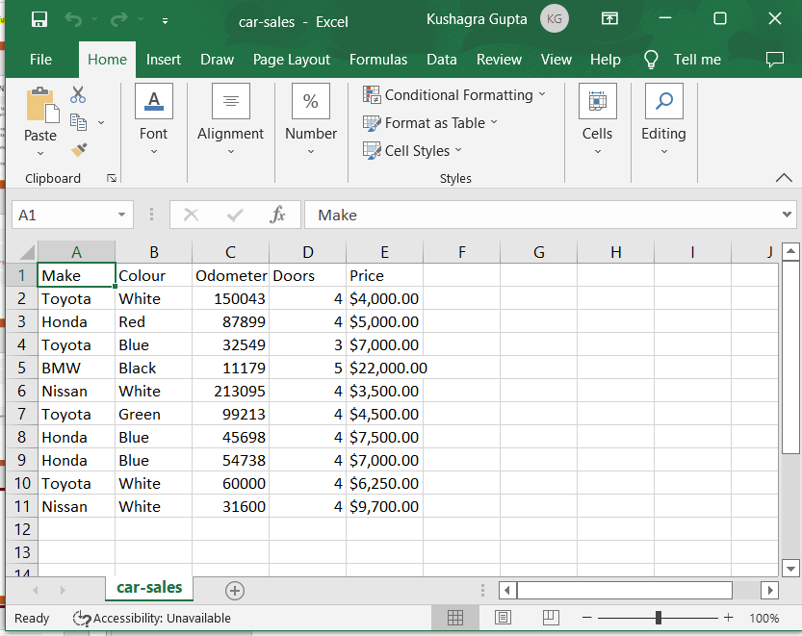

















Slide 15
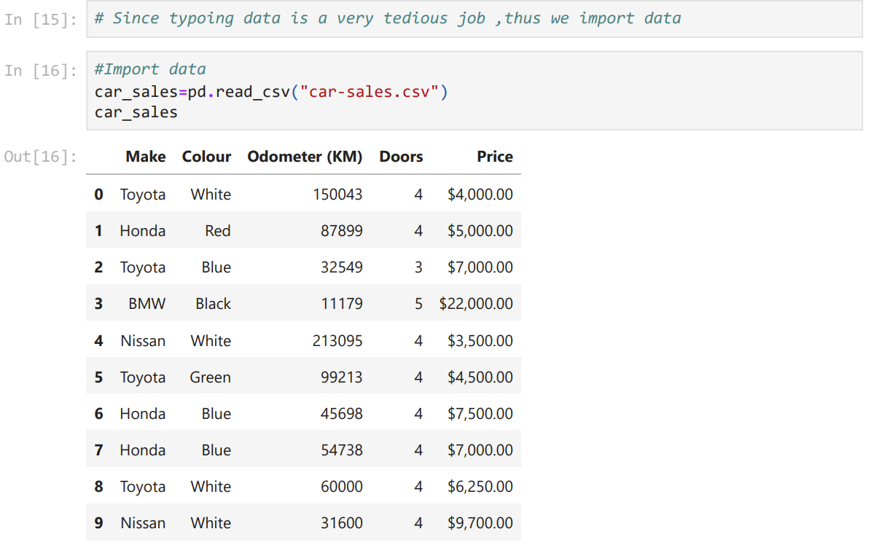

Slide 16
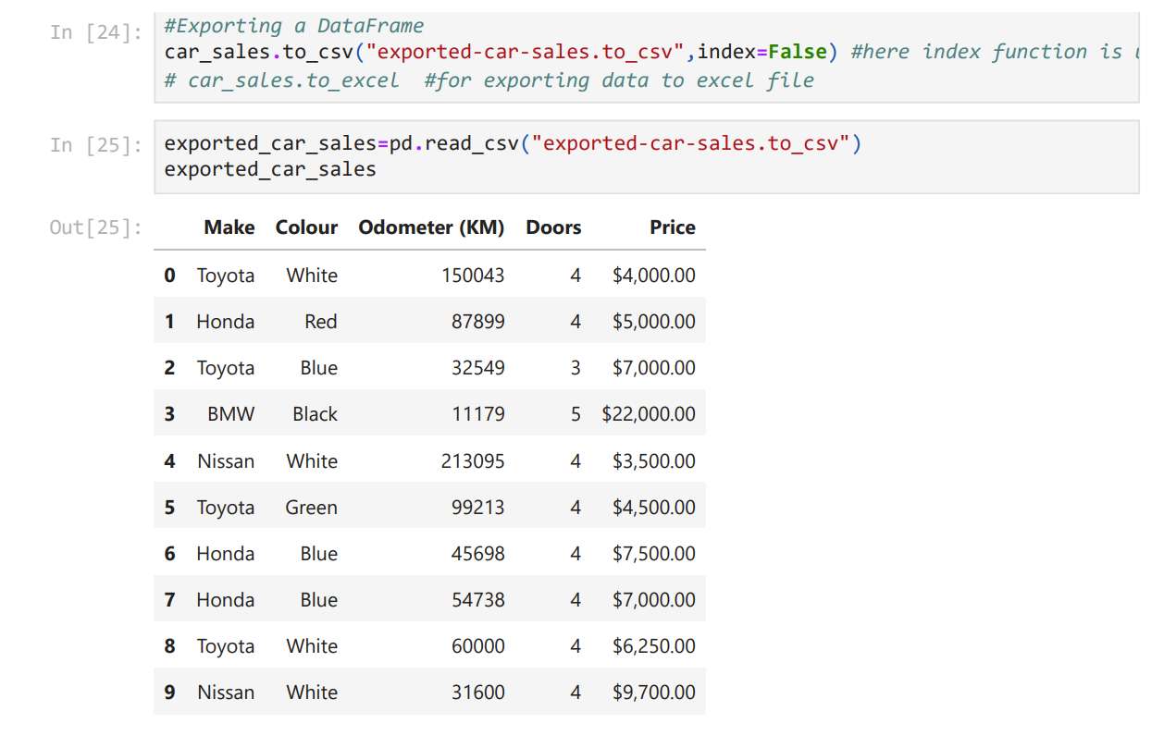

Slide 17
Let me Emphasize over the index function
By default when you export data from a dataframe in python, it creates its own indexing for our convenience. But often we already have our own indexing done, so to avoid confusion we remove the indexing provided by default.

Slide 18
Describing Data

Slide 19
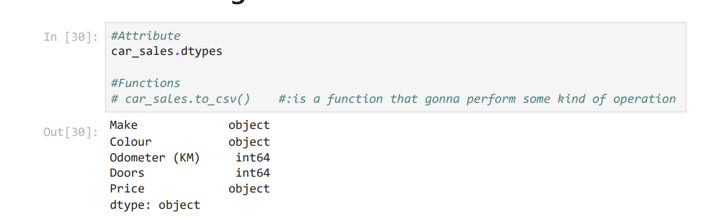


Slide 20
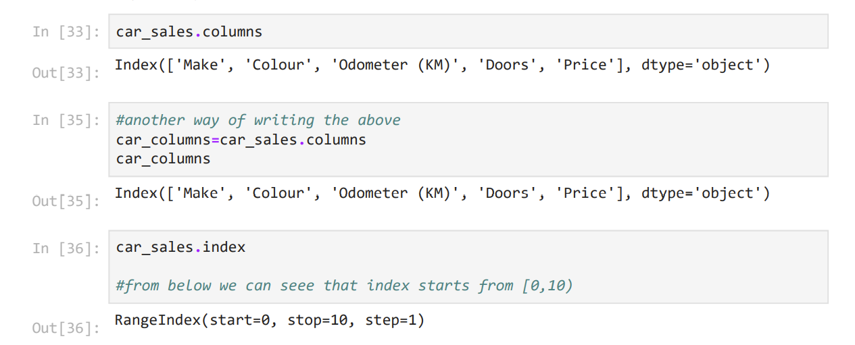

Slide 21
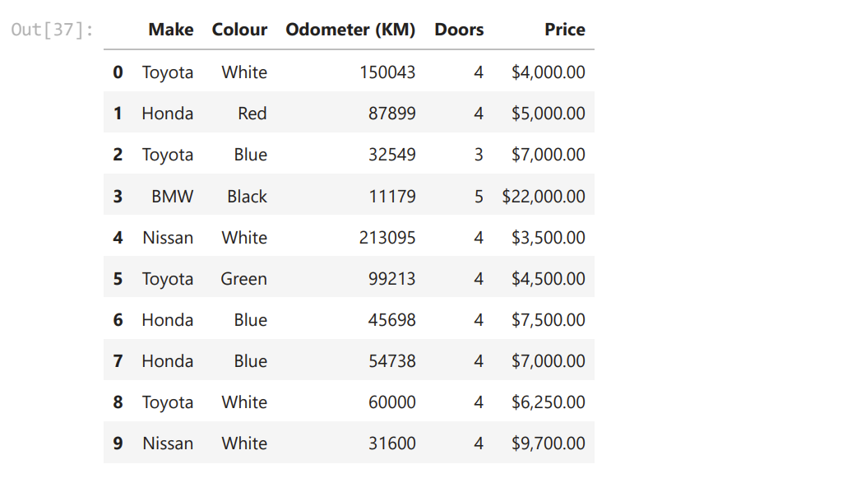

Slide 22
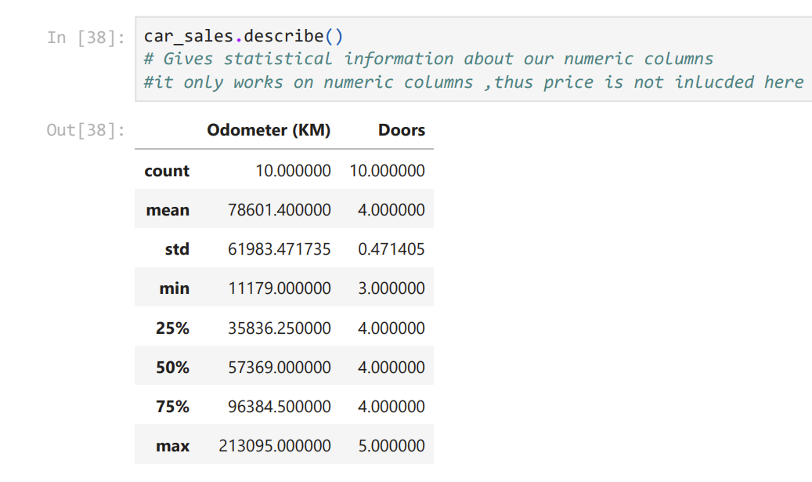











Slide 23
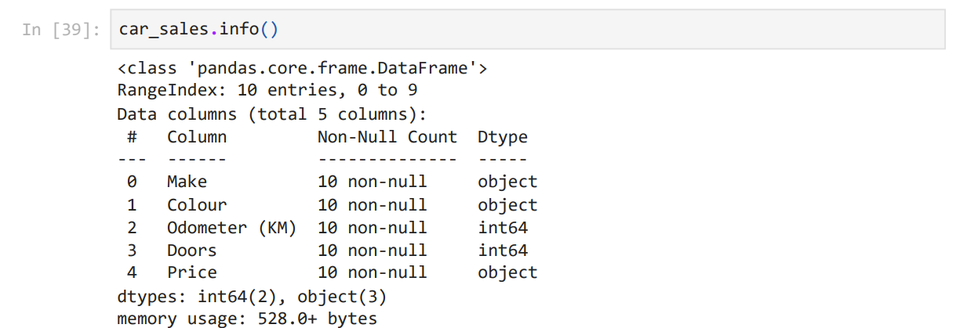

Slide 25
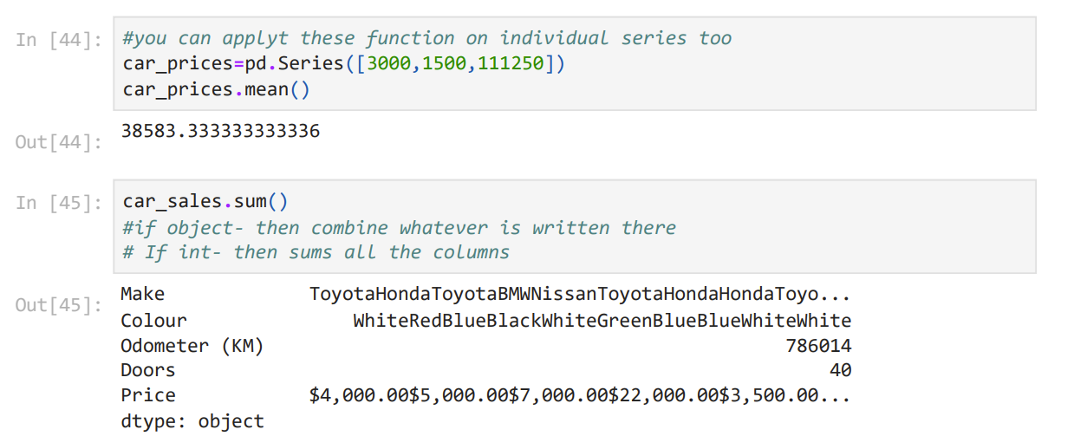

Slide 26
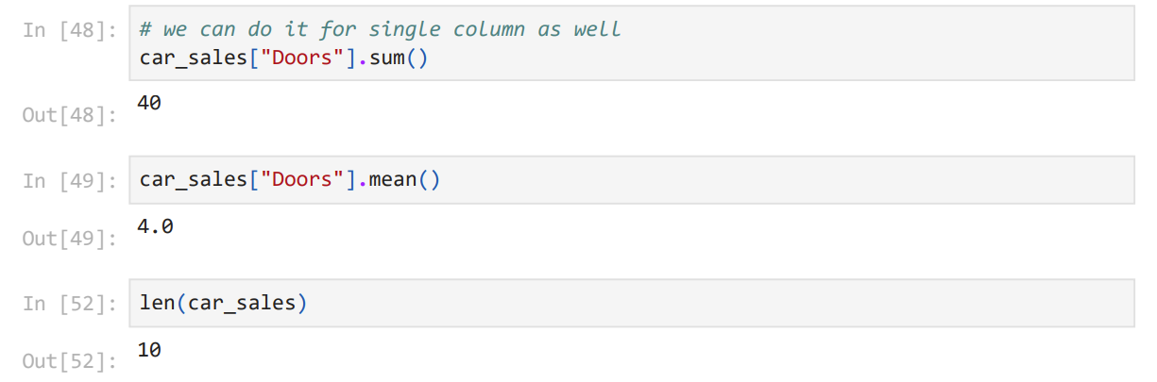

Slide 27
Viewing and Selecting Data

Slide 28
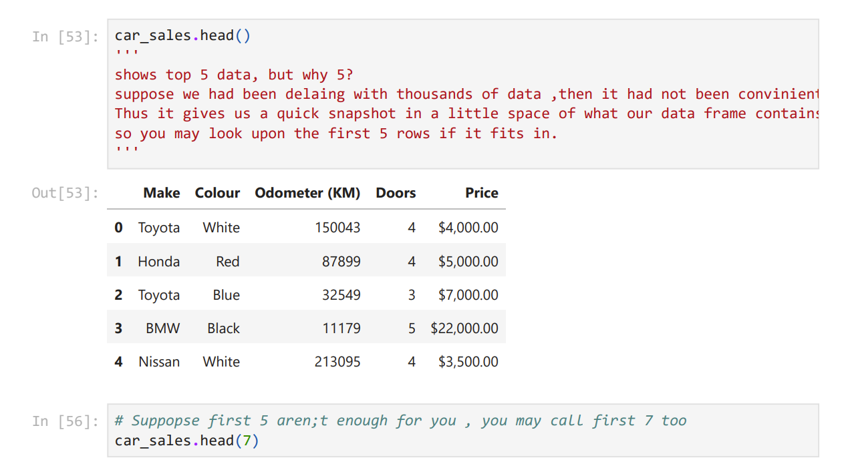

Slide 29
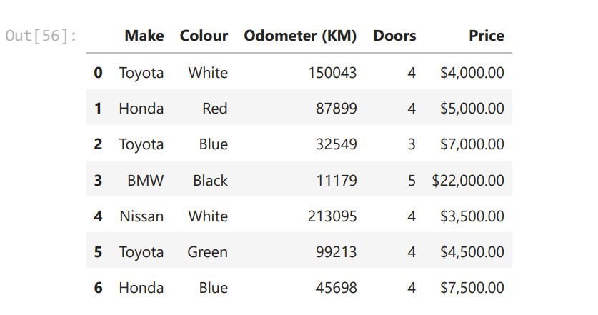

Slide 30
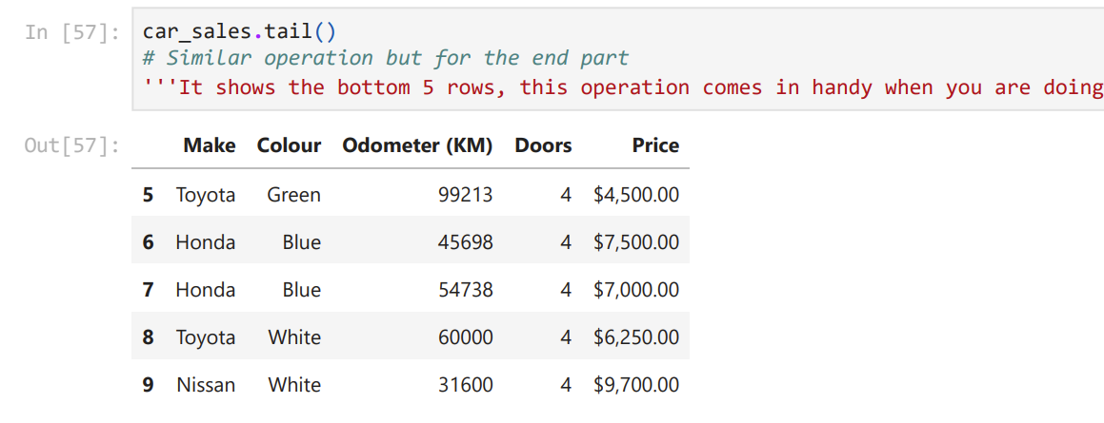

Slide 31
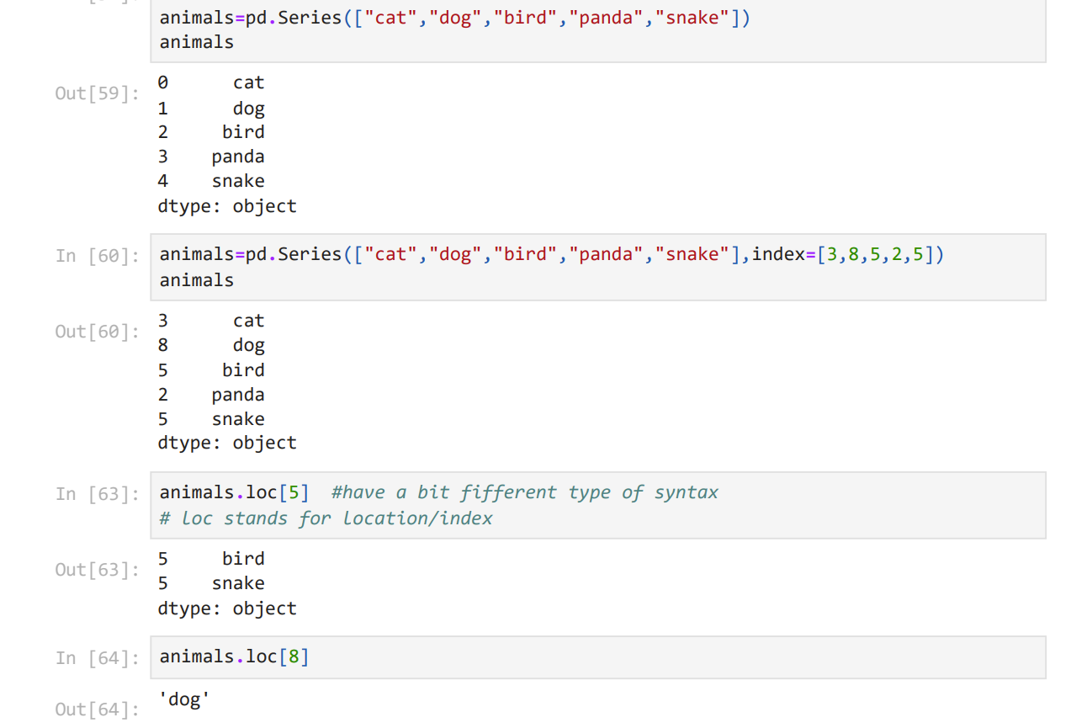

Slide 32













Slide 33
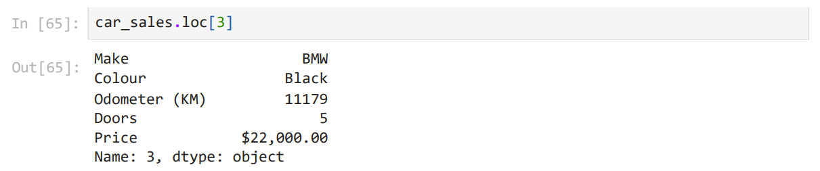

Slide 34
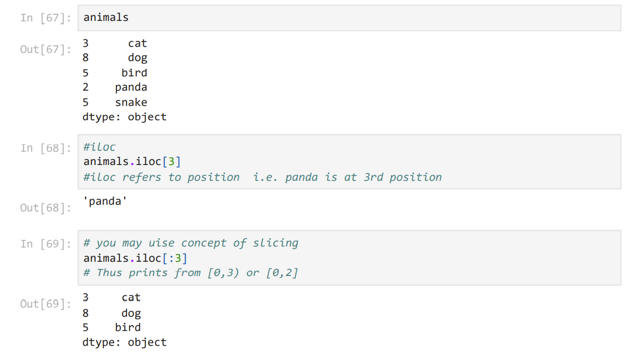

Slide 35
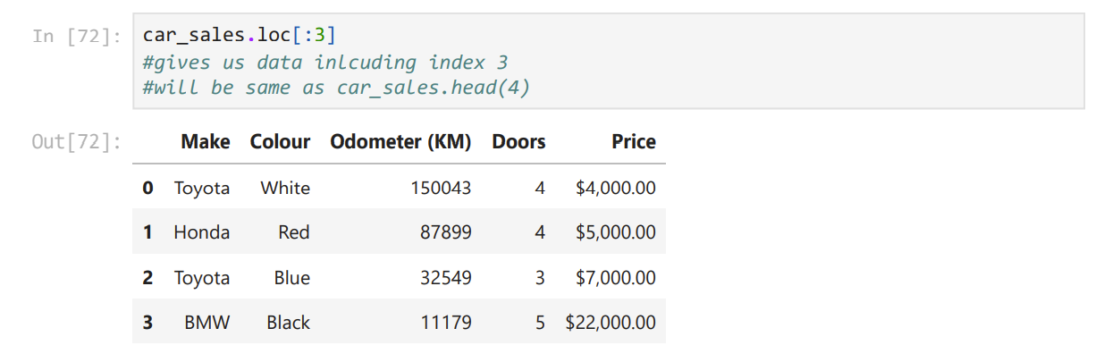
Thus Not more of a difference between loc and iloc

Slide 37
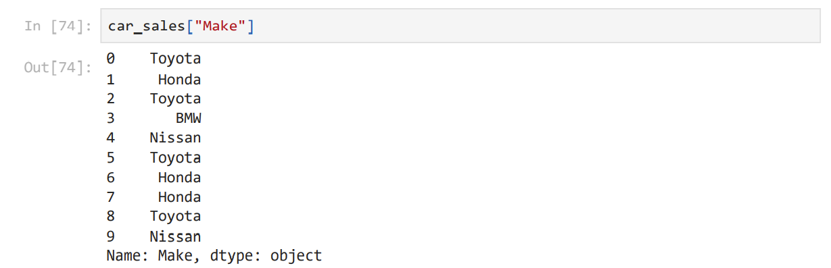

Slide 38
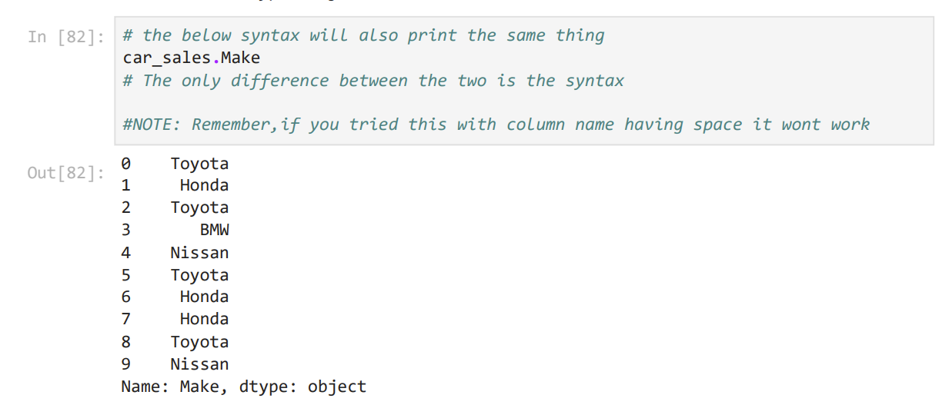
Another way of writing the same thing…

Slide 39
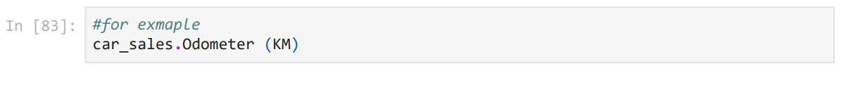
What do you think should be the output?

Slide 40
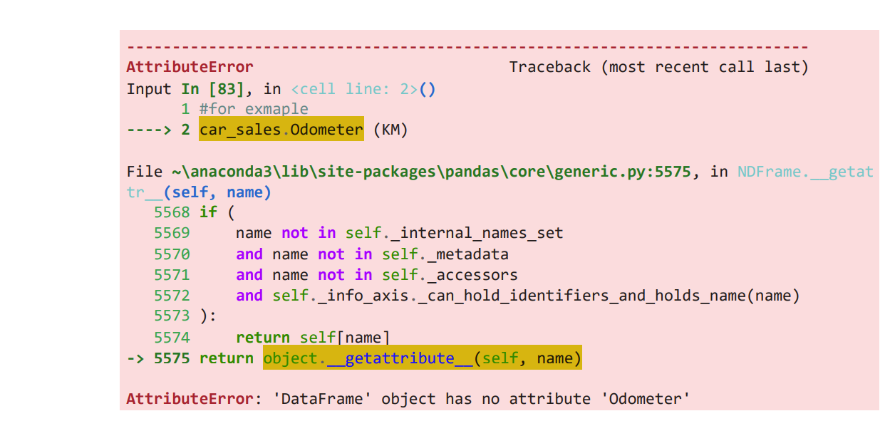





Slide 41
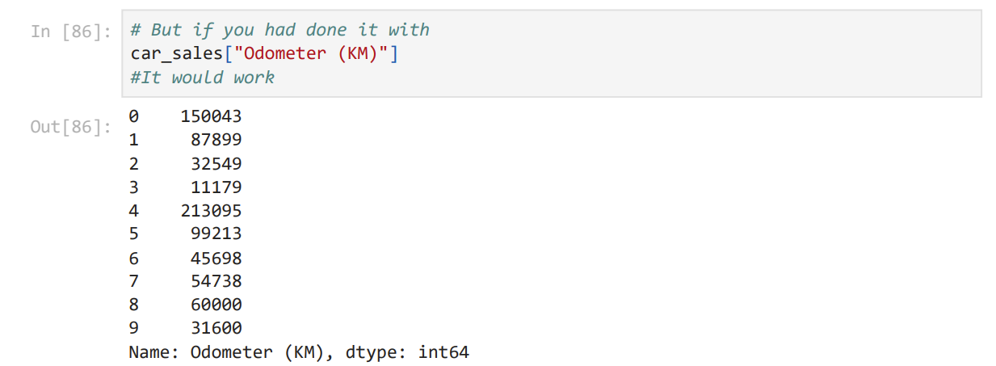
Correct way:

Slide 42
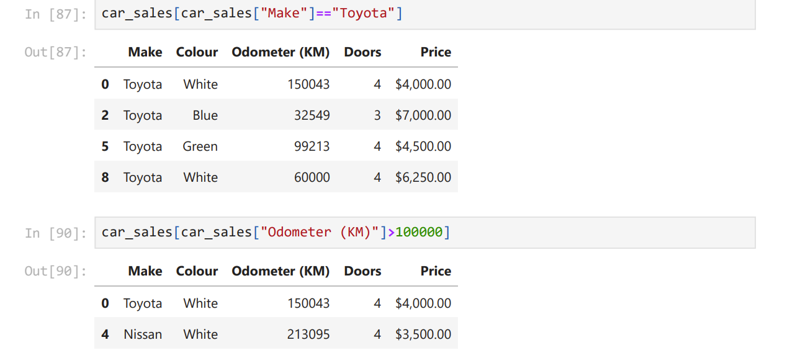

Slide 43
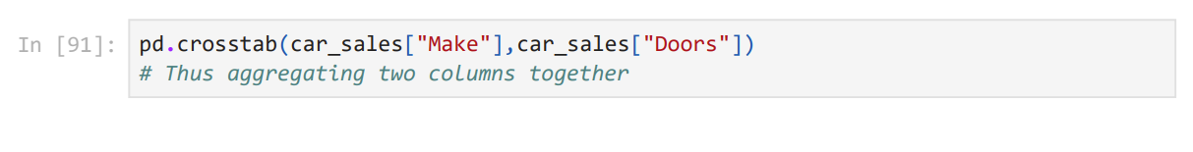
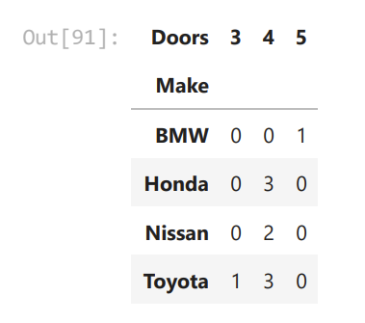





Slide 44
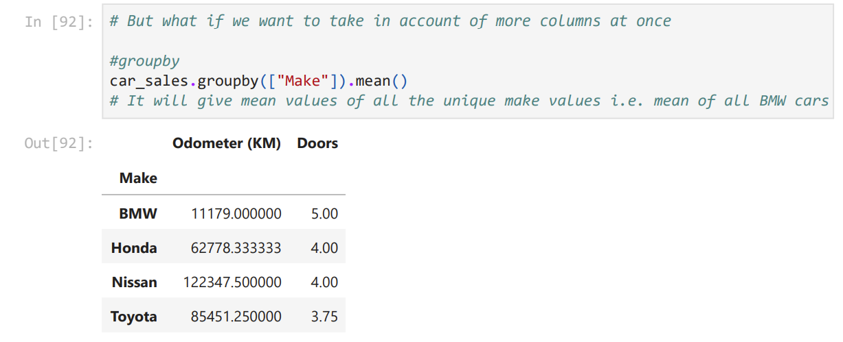









Slide 45
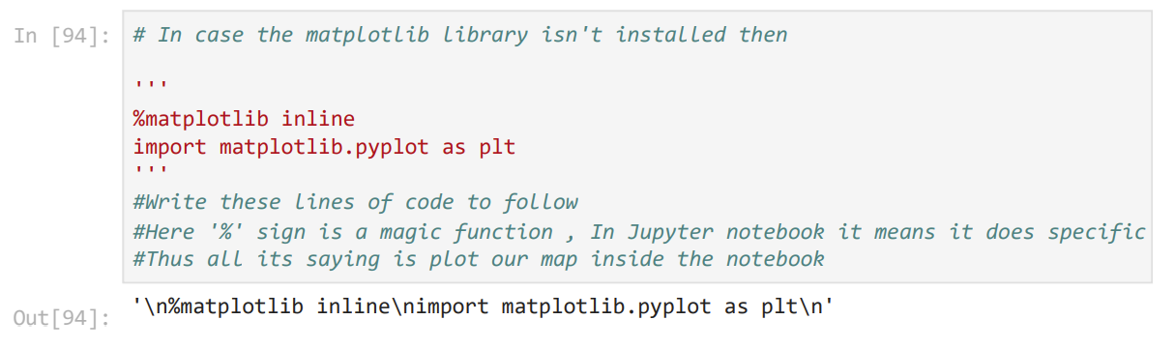
For the next chunk install matloplib Library if not done already

Slide 46
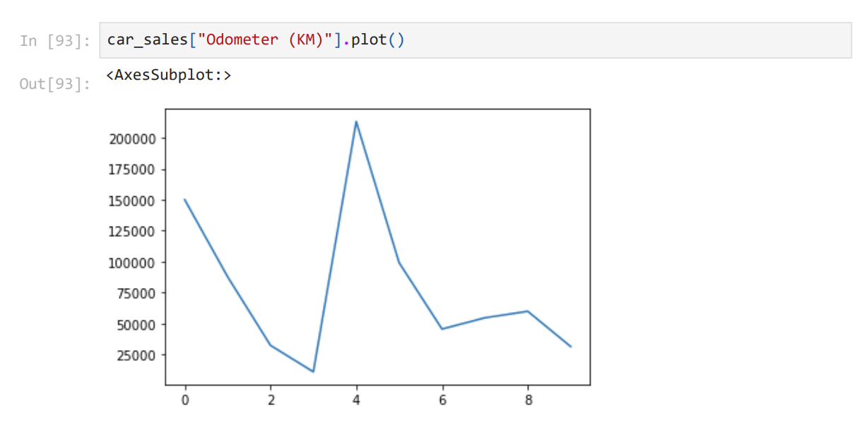

Slide 47
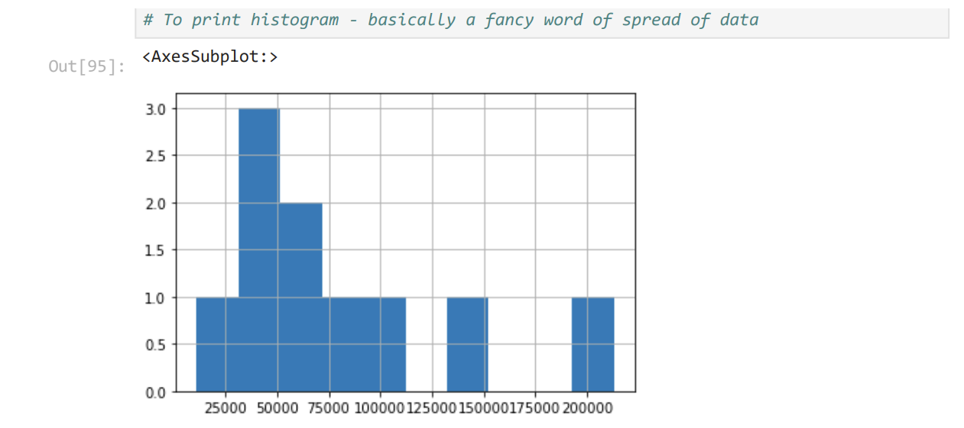

Slide 48
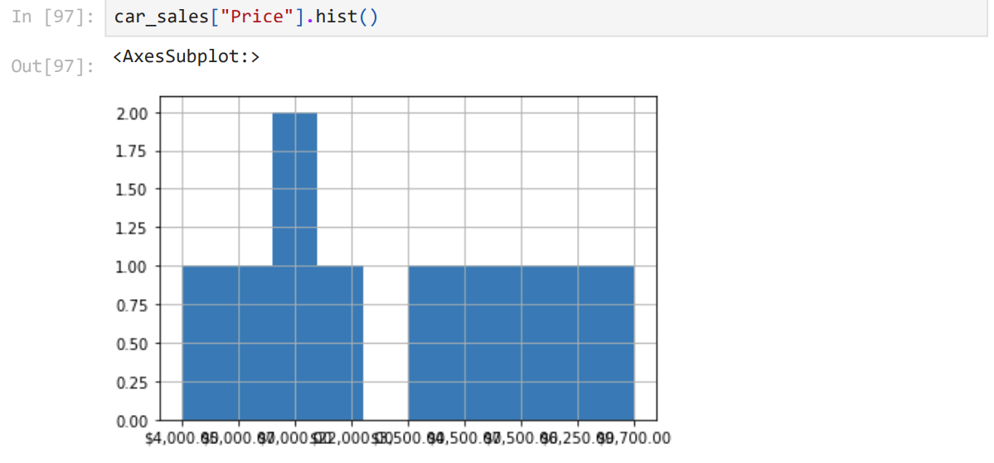













It may show an error for you as well since price is an object and not int

Slide 49


Slide 50
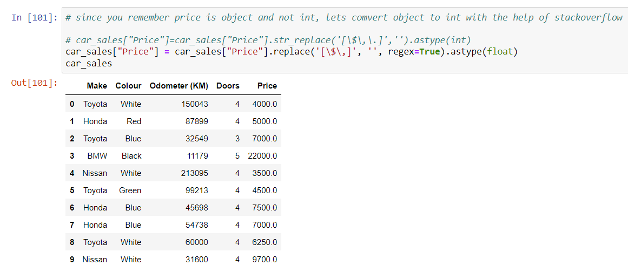

Slide 51
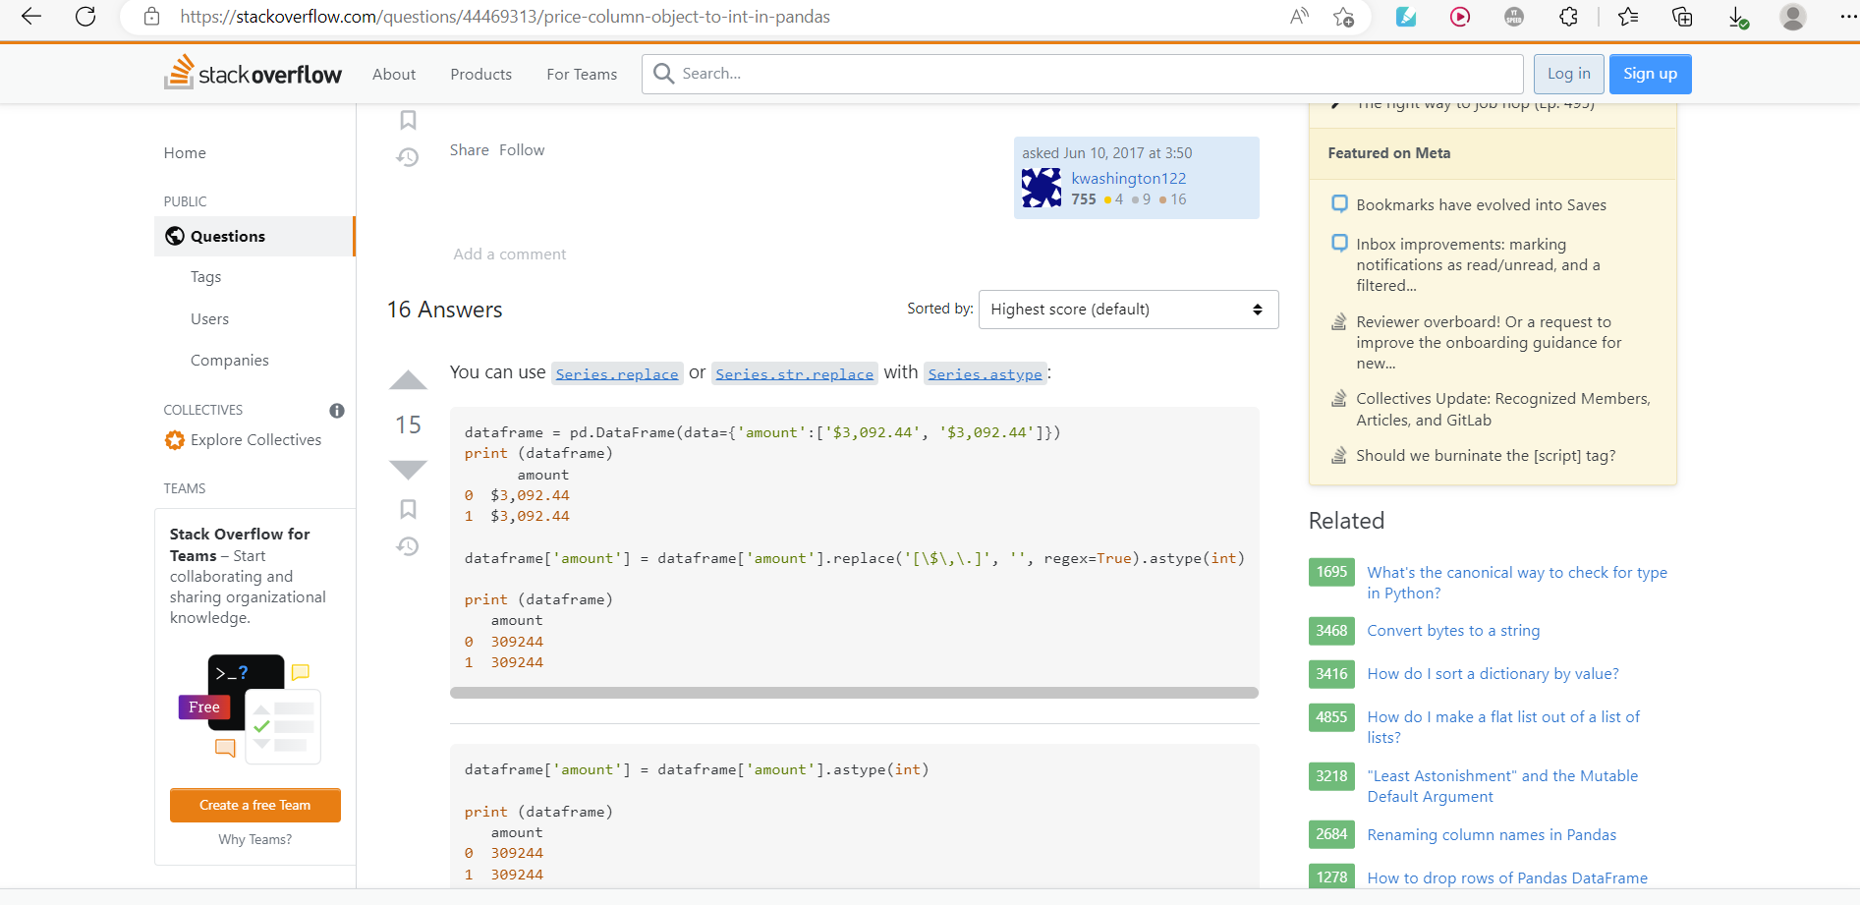

Slide 52
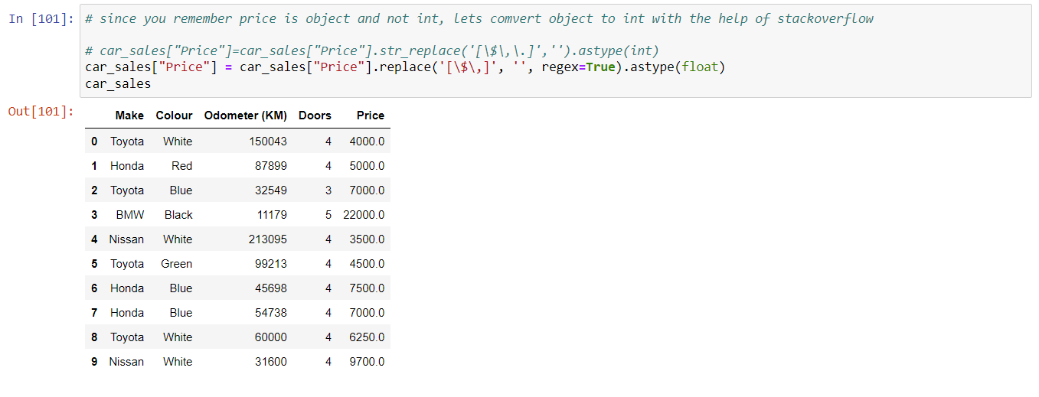
Manipulating results as per our need

Slide 53
Manipulating Data

Slide 54
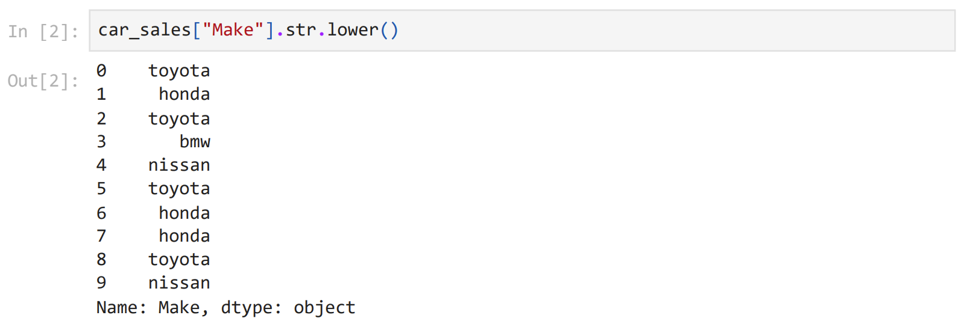

Slide 56
OOPS, the results didn’t update.
Can you guess why?

Slide 57
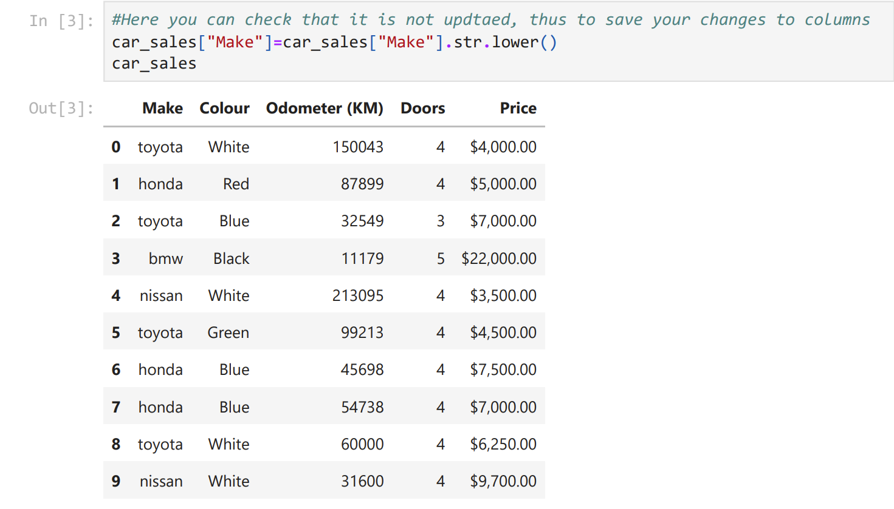

Slide 58
Let’s deal with some missing data now

Slide 59
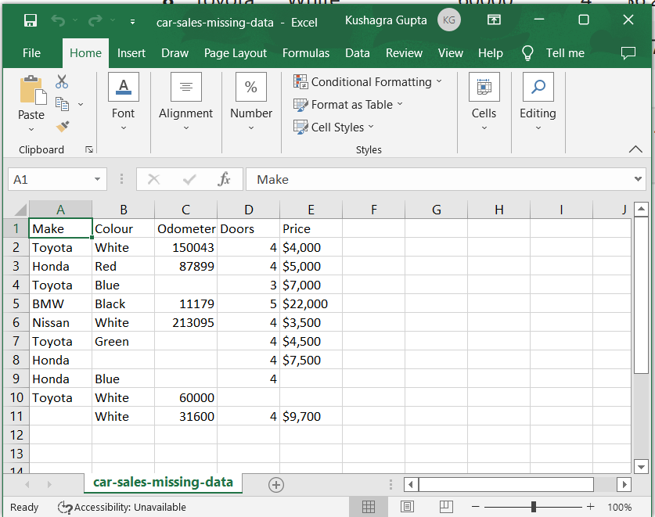

Slide 60
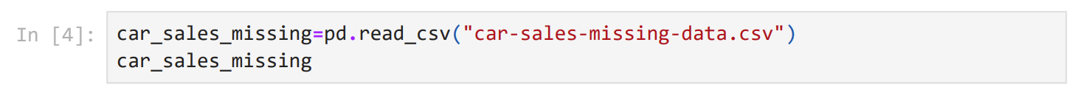
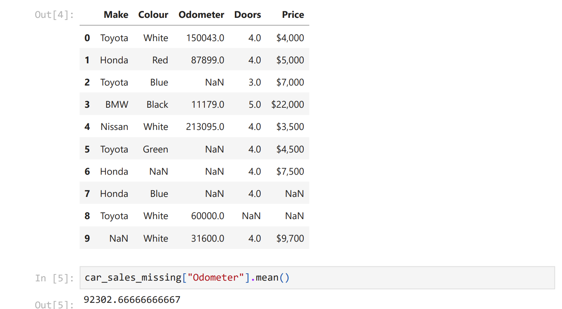


Slide 61
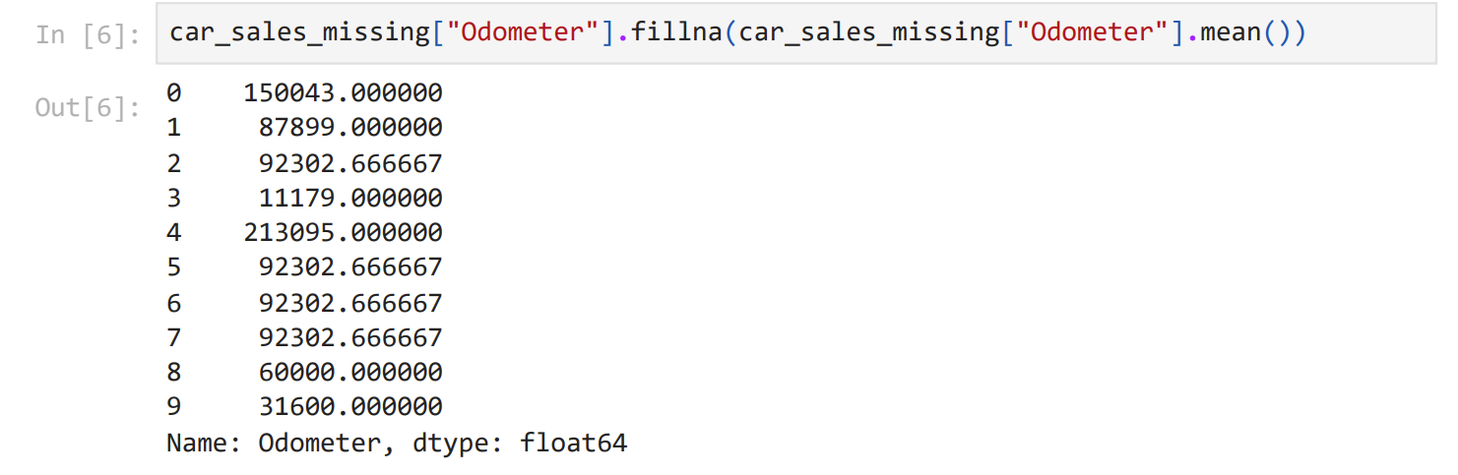

Slide 62
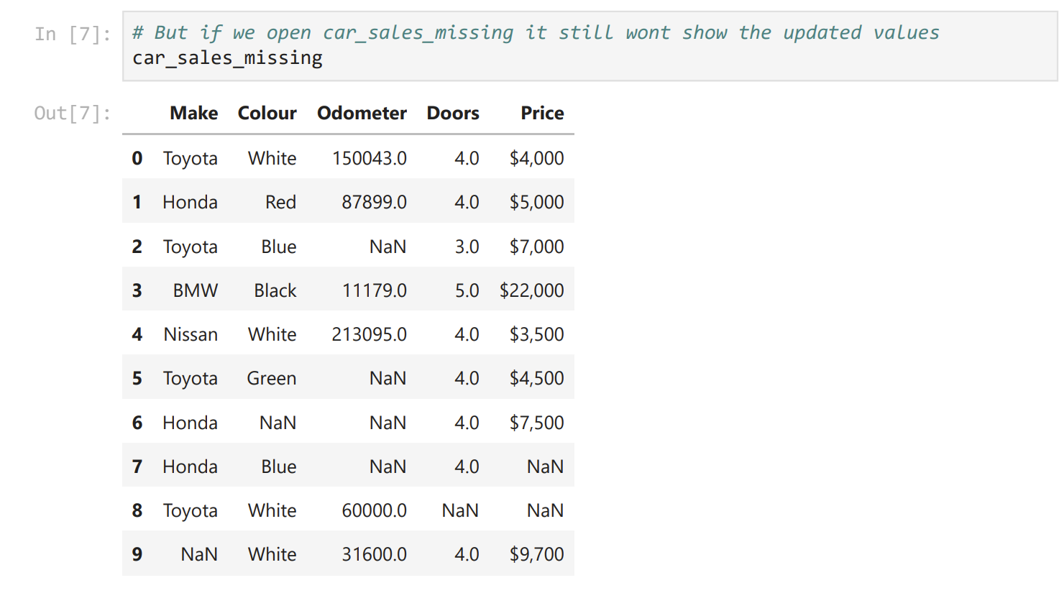



















Slide 63
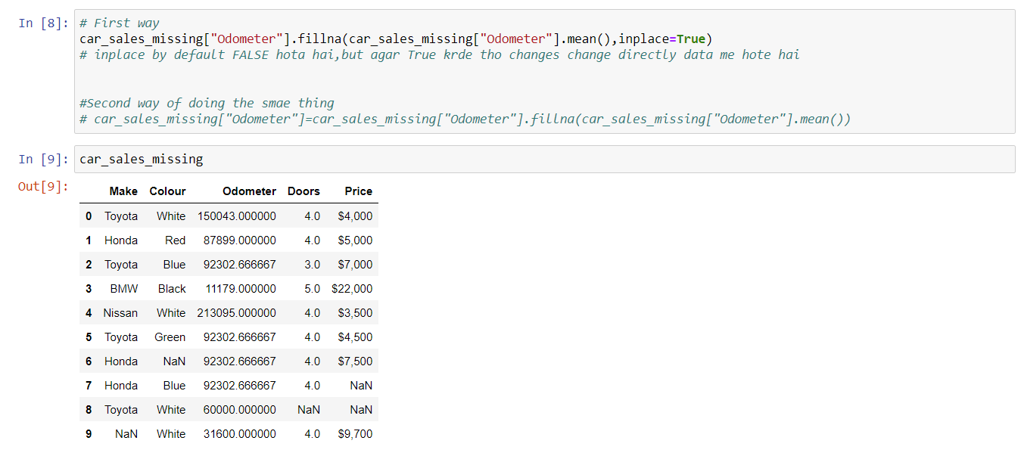

Slide 64
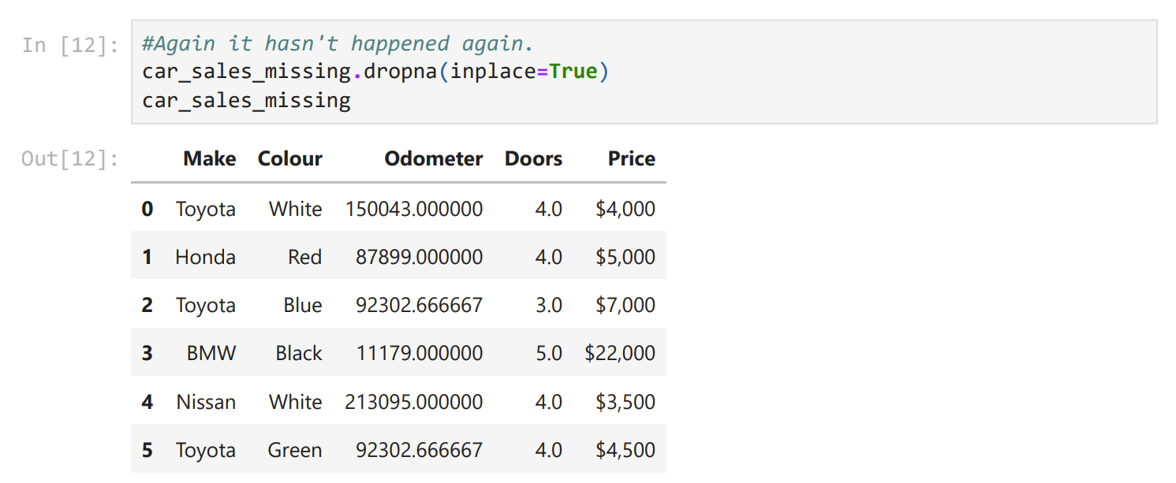

Slide 65
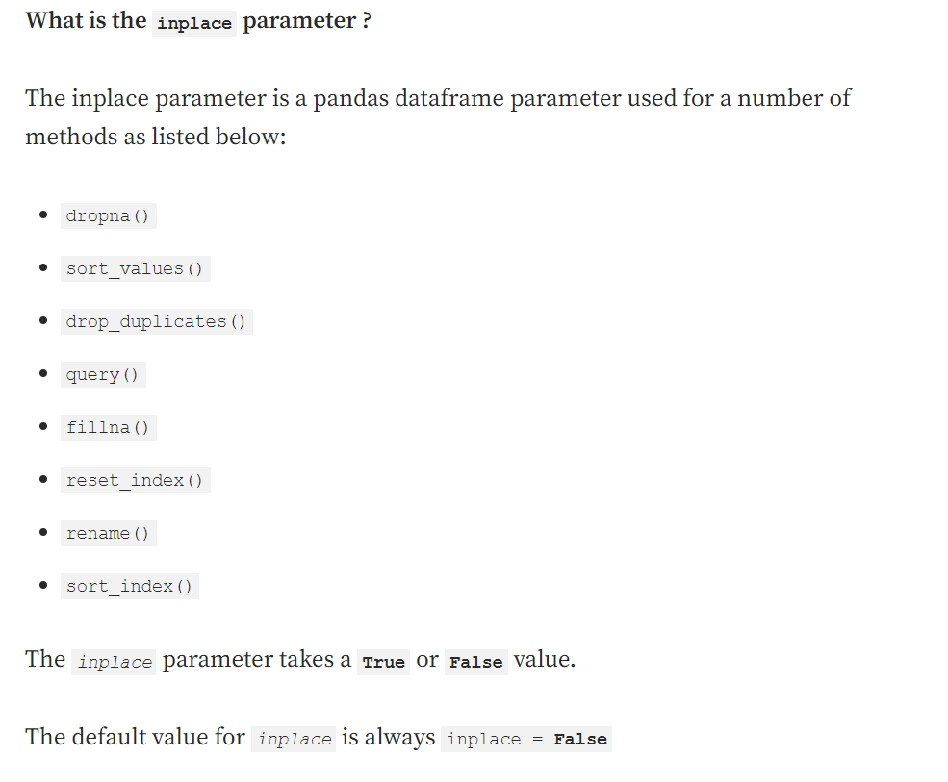



















Slide 66



Slide 67
































































Slide 68














Slide 69



Slide 70


Slide 71


Slide 72


Slide 73


Slide 74


Slide 75



Slide 76


Slide 77

Thank you everyone

Slide 78

Thanks for your patient hearing.
Any doubts regarding the course of this session are welcome!

